Slide 1
IT 304 Computer Networks Introduction Week 2-Lecture 3

Slide 2
Protocol “layers”
Networks are complex,
with many “pieces”:
hosts
routers
links of various media
applications
protocols
hardware, software

Slide 3
Organization of air travel
ticket (purchase)
baggage (check)
gates (load)
runway takeoff
airplane routing
ticket (complain)
baggage (claim)
gates (unload)
runway landing
airplane routing
airplane routing
a series of steps

Slide 4
Layering of airline functionality
ticket (purchase)
baggage (check)
gates (load)
runway (takeoff)
airplane routing
ticket (complain)
baggage (claim
gates (unload)
runway (land)
airplane routing
ticket
baggage
gate
takeoff/landing
airplane routing
airplane routing
airplane routing
departure
airport
intermediate air-traffic
control centers
arrival
airport
layers: each layer implements a service
via its own internal-layer actions
relying on services provided by layer below

Slide 5
Question:
How is the Internet structured?

Slide 6
Why layering?
dealing with complex systems:
explicit structure allows identification, relationship of complex system’s pieces
layered reference model for discussion
modularization eases maintenance, updating of system
change of implementation of layer’s service transparent to rest of system

Slide 7
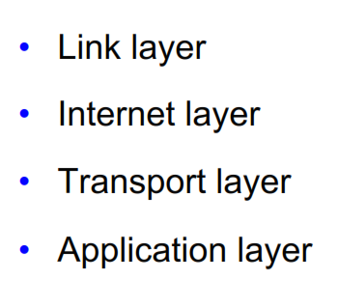
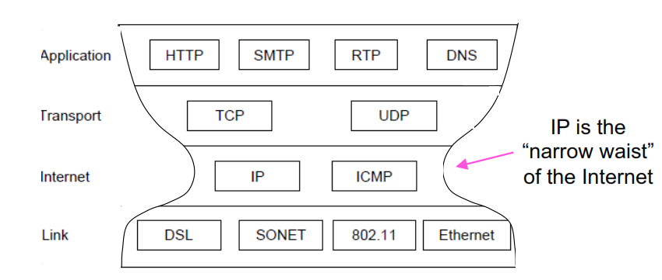
The TCP/IP Model
Vint Cerf and Bob Kahn
Kleinrock's "Narrow Waist" Model

Slide 8
Internet protocol stack
application: supporting network applications
FTP, SMTP, HTTP
transport: process-process data transfer
TCP, UDP
network: routing of datagrams from source to destination
IP, routing protocols
link: data transfer between neighboring network elements
Ethernet (802.3), WiFi (802.11), PPP
physical: bits “on the wire”
application
transport
network
link
physical

Slide 9
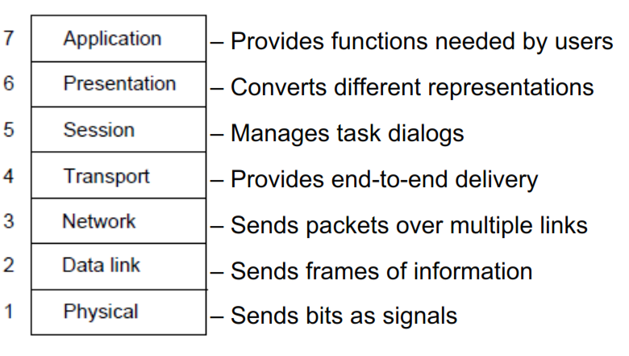
The Open Systems Interconnection (OSI) Reference Model by International Standards Organization (ISO)
Layers created for different abstractions
Each layer performs well-defined function
Function of layer chosen with standards in mind
Minimize information flow across layer interfaces
Find the optimum number of layers

Slide 10
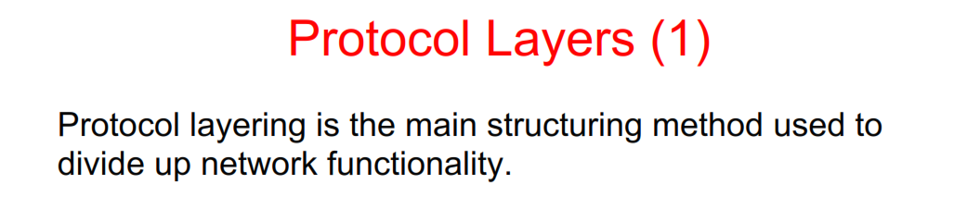
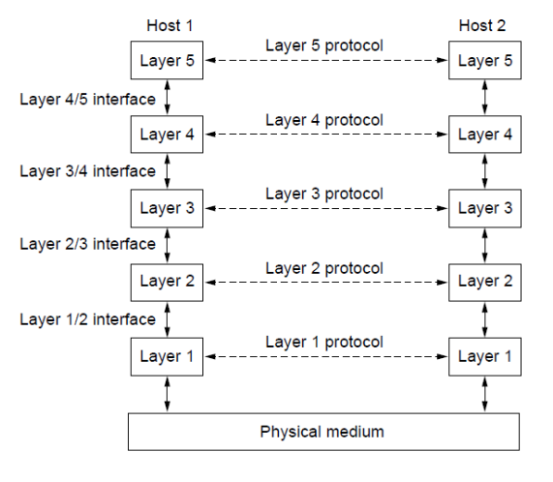
Each protocol instance talks virtually to its peer
Each layer communicates only by using the one below
Lower layer services are accessed by an interface
At bottom, messages are carried by the medium

Slide 11
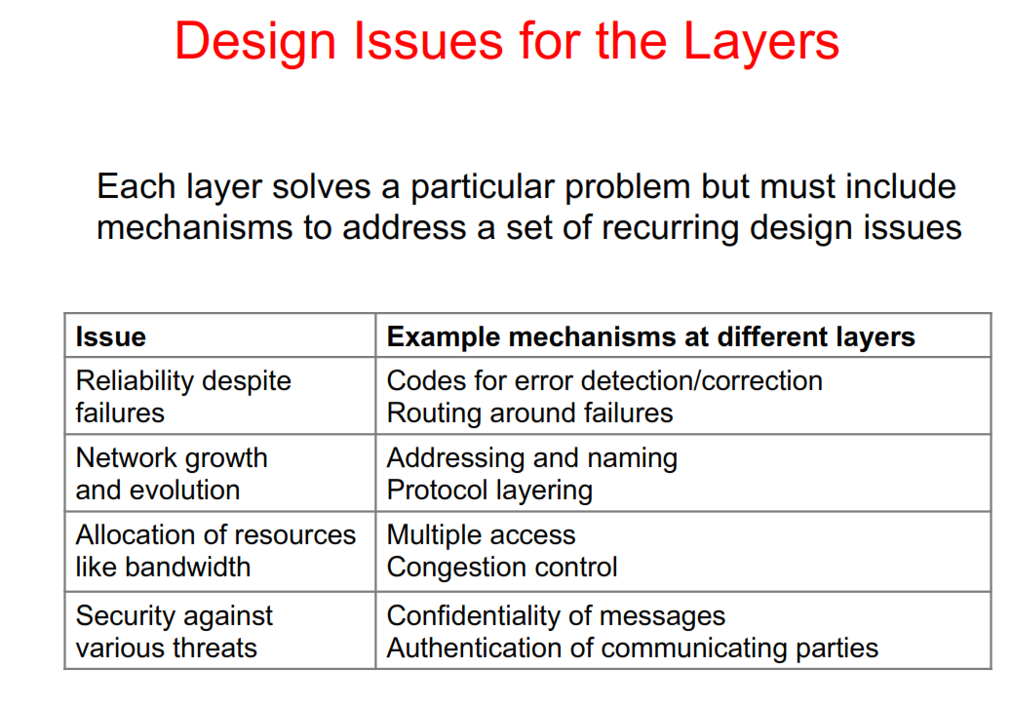

Slide 12
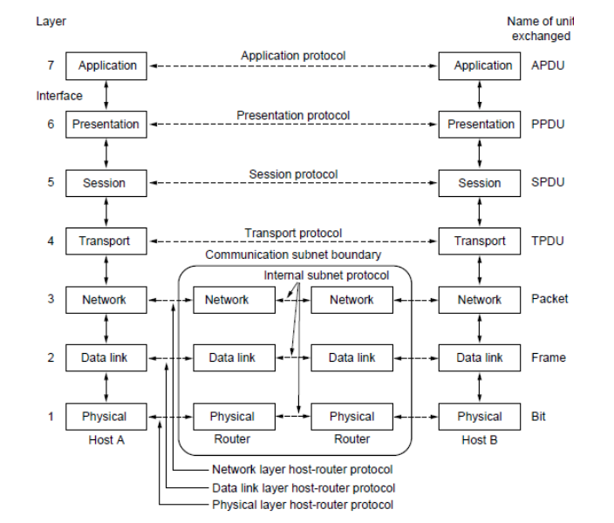
PDU is Protocol Data Unit

Slide 13

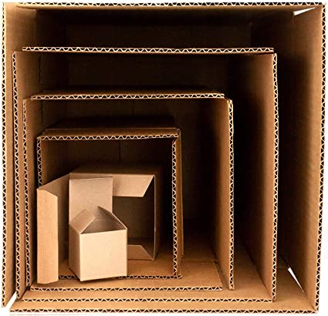
Who is the source (S) computer?
Who is the destination (D) computer?
Who is passing this message to whom?
A gift box example for encapsulating / packing message from S to D

Slide 14

Encapsulation
source
message
M
application
transport
network
link
physical
segment
H_{t}
M
H_{t}
datagram
H_{n}
H_{n}
H_{t}
M
frame
H_{l}
H_{n}
H_{t}
M
link
physical
switch
destination
H_{n}
H_{t}
M
network
link
physical
M
application
transport
network
link
physical
H_{l}
H_{n}
H_{t}
M
H_{n}
H_{t}
M
H_{t}
M
H_{n}
H_{t}
M
H_{l}
H_{n}
H_{t}
M
router

Slide 15
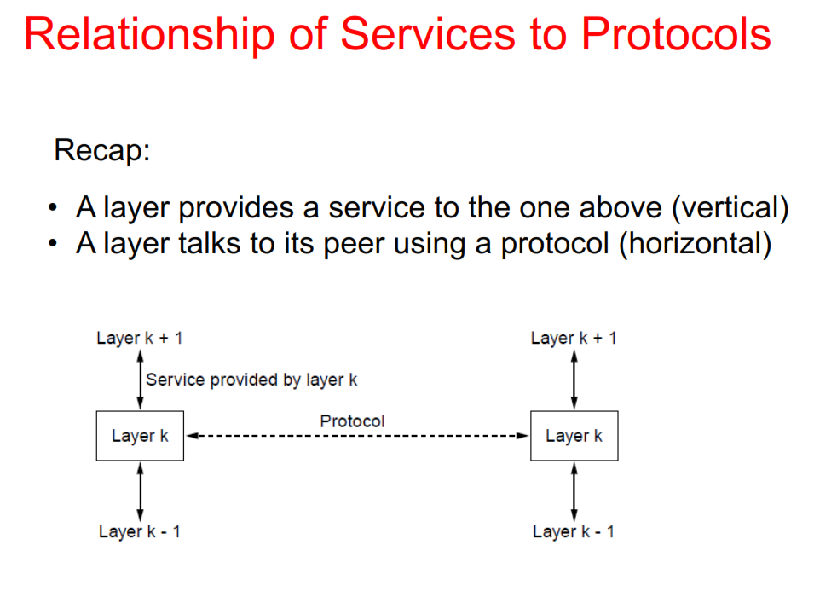
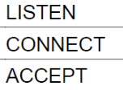

Slide 16
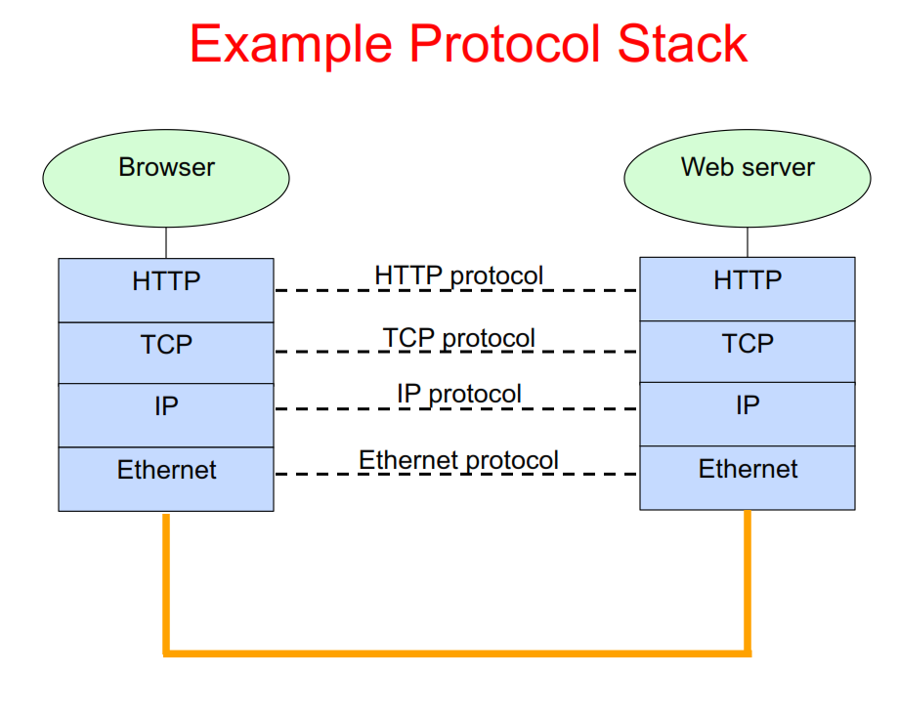

Slide 17
